Slide 1
A Beginner’s Review and Refresher to Being a Trustee

Slide 2
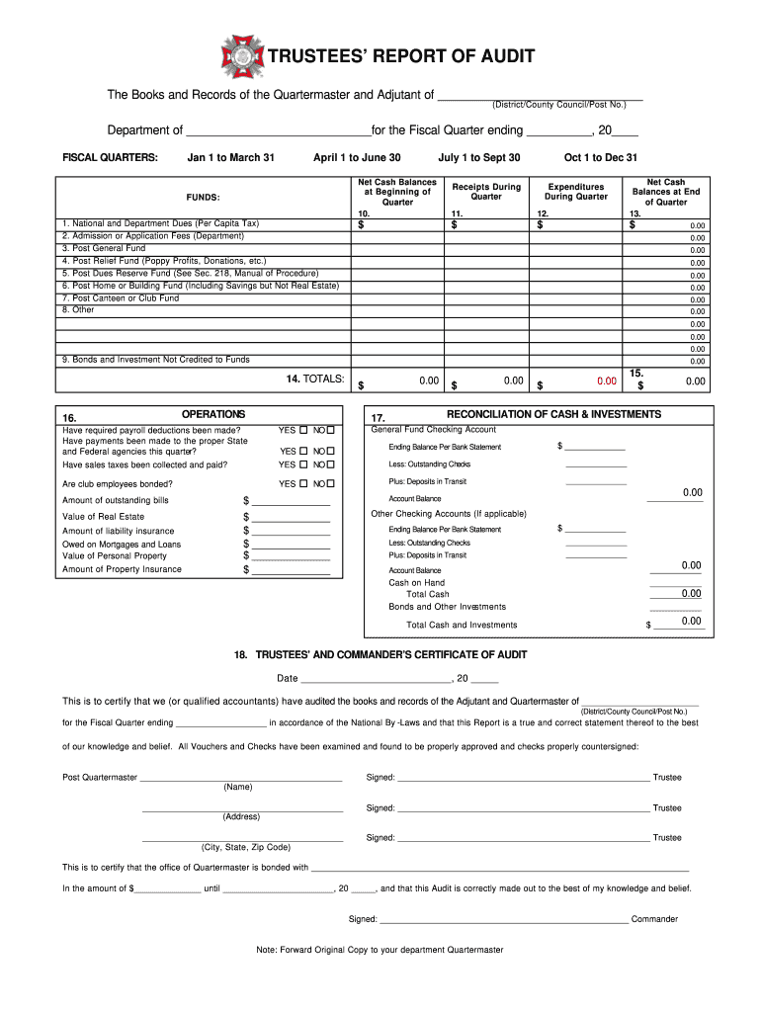
What is a VFW Post Trustee
The Post Trustee is:
The reviewer of Quartermaster and Adjutant records
First line of defense against embezzlement
Not allowed to serve on a committee whose records are audited
Elected to a three-year term

Slide 3
Duties of the Post Trustee
The duties are set forth in the National Manuel of Procedure, Section 218(a)(11)
Review Monthly Report of Receipts and Expenditures.
Complete a full audit within 30 days .
The audit shall be in accordance and on an Adjutant General approved form.
Perform other duties as may be required.

Slide 4
What To Watch Out For!
Deposits of only a portion of the proceeds
Check stubs payable to someone else and check made out to QM, Commanders or Bar Managers / Bingo Chairs (People in charge of the money)
Securing personal loans with a Post check
Fake Bank statements / Fake break-ins
Collection of dues or raffle money, but not deposited
Cashed Post bonds/investments, pocketed the money
Paid personal credit cards with Post funds or used Post checking account or credit card for personal use.

Slide 5
Danger Signs
Stalling with getting books ready
Slowness in paying bills or delay in depositing
Carrying large amounts of “Cash on Hand”
Incorrect information on checks
Complaints from “Members” who haven’t received ID card or magazine
Uncleared checks
Lifestyle changes of the QM, Commander or Employee (People in charge of the money)

Slide 6
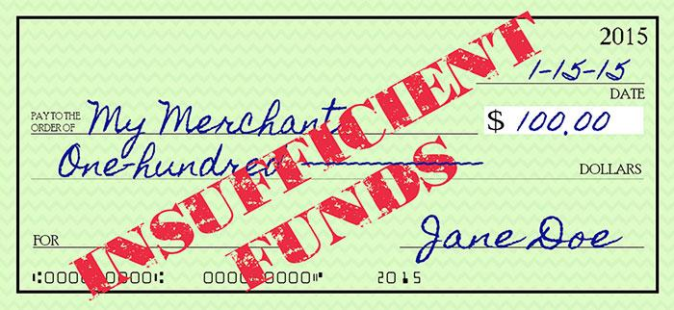
Canteen Issues
Padded liquor inventory
Bad or fictitious checks made out to “Cash”
Leakage of petty cash
Padded payroll
Bootlegging on the side
Kickbacks from suppliers
Gambling operations on the side
Employees stealing inventory

Slide 7
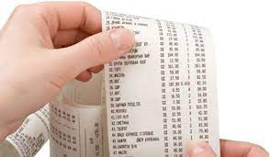
Complete Audit of ALL Post Business Operations
Review and approve all regular, monthly inventory taken by Board of Management
Dated cash register tapes or POS for each day
Day sheet of bar sales for each day
Check stubs, cancelled checks, bank statements
Receipts for all bills paid in cash (Should be NONE)
Records of all stock purchases
Accounting for income from all non-bar sources

Slide 8
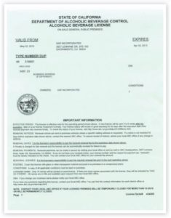
Complete Audit of ALL Post Business Operations
Completed federal and state payroll tax forms
Payroll records
All licenses and permits
All bills and vouchers
List of unpaid bills
Other records as necessary

Slide 9
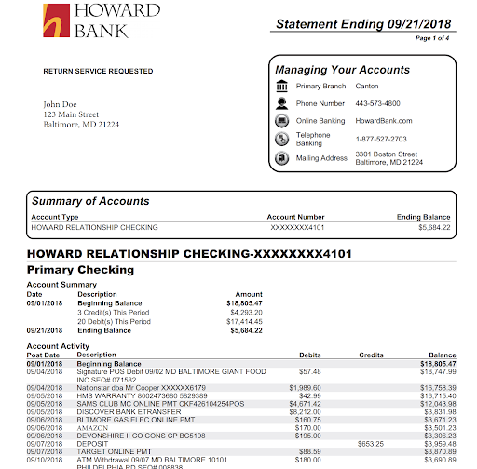
Completing The Report Of Audit
Documents you will need to complete the audit:
Last quarter’s audit
The three Quartermaster’s Monthly Reports for the quarter
Quartermaster’s Ledger
All Deposits
All Expenditures (Receipts)
Statements
Checking Account(s)
Savings
Investments
Tax filings

Slide 10
Completing The Report Of Audit (cont.)
Complete the top with the correct Post Number and date of the Fiscal Quarters end. You will add the District number and then the Post number.

Slide 11
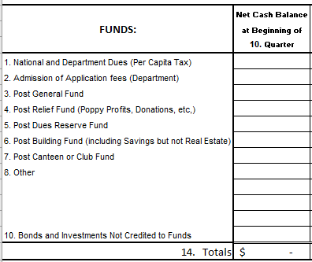
Completing The Report Of Audit (cont.)
The FUNDS should already be set by the Post Quartermaster.
Take the previous quarterly audit and write the ending balances for each fund as the beginning balance for this audit.

Slide 12
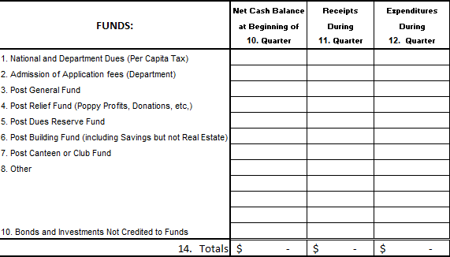
Completing The Report Of Audit (cont.)
If you have been reviewing the Quartermaster’s Monthly Reports, all you need to do is add up the 3 monthly reports’ receipts and expenditures for each fund and notate the sum in the appropriate column.

Slide 13
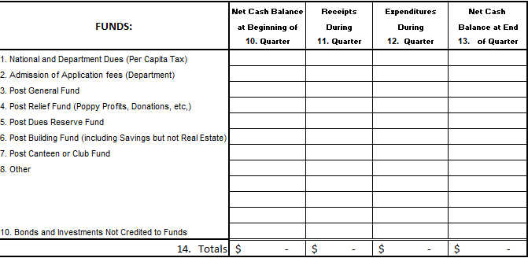
Completing The Report Of Audit (cont.)
Next, take your starting Fund balance, add your receipts, subtract your expenditures and the total will be your ending balance.
You need to add each column also to note totals in Boxes 14 and 15.

Slide 14
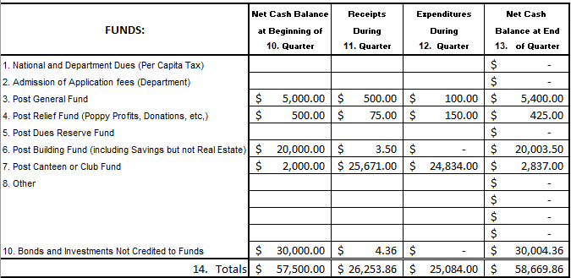
Example

Slide 15
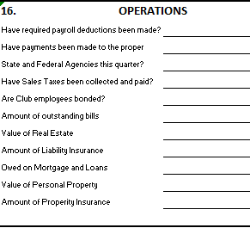
Completing The Report Of Audit (cont.)
Check payroll records and State and Federal tax filings to ensure payroll tax, use tax, and sales tax has been paid.
The bottom part of Box 16 should remain constant for the year.

Slide 16
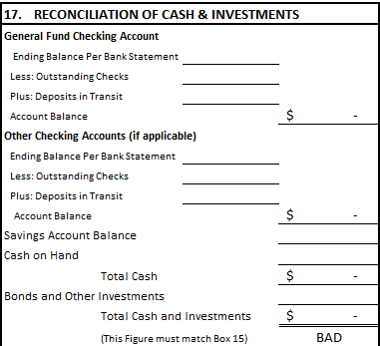
Completing The Report Of Audit (cont.)
Next you will enter the ending balance of the main checking account for the last day of the quarter.
Then enter any outstanding checks or deposits in transit.
This will give you your account balance.

Slide 17
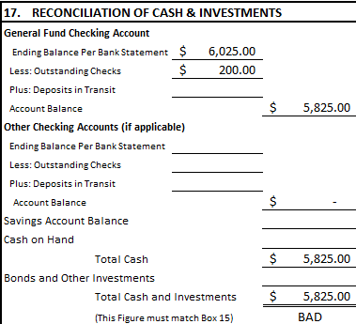
Example

Slide 18
Completing The Report Of Audit (cont.)
Next, if you have a separate checking account for the canteen (recommended), you will complete the same as the General Fund Checking Account.

Slide 19
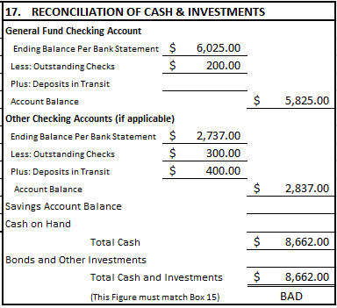
Example

Slide 20
Completing The Report Of Audit (cont.)
Lastly, you will enter the amounts from any Savings Accounts and/or Bonds and Investment Accounts.

Slide 21
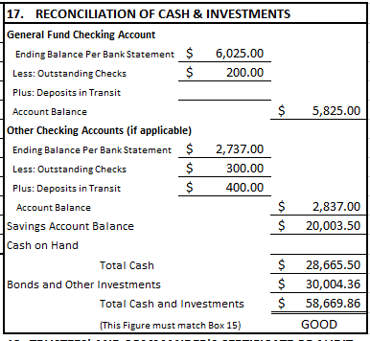
Example
If the Quartermaster’s accounting and the bank statements match, then Box 17’s bottom line will match Box 15’s total.

Slide 22
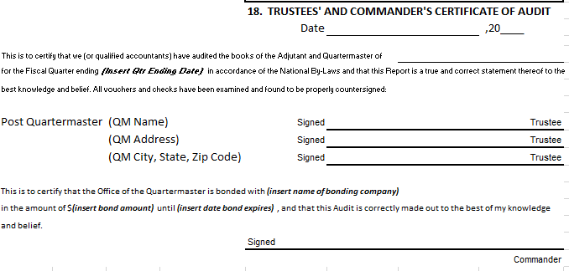
Completing The Report Of Audit (cont.)
To finalize the audit, the information in Box 18 must be completed which includes at least two (2) Trustee’s signatures and the Post Commander’s signature.

Slide 23
In Review
The Post must maintain a Relief Fund (Section 219)
Column 13, Ending Balance shall not be a negative number
Double check your math
Must have a General Fund and Relief Fund
If you keep cash on hand, it should be noted in FUNDS
You must submit an audit with the appropriate signatures

