Slide 1
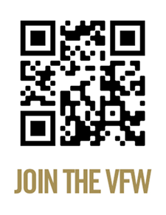
Membership Drives

Slide 2
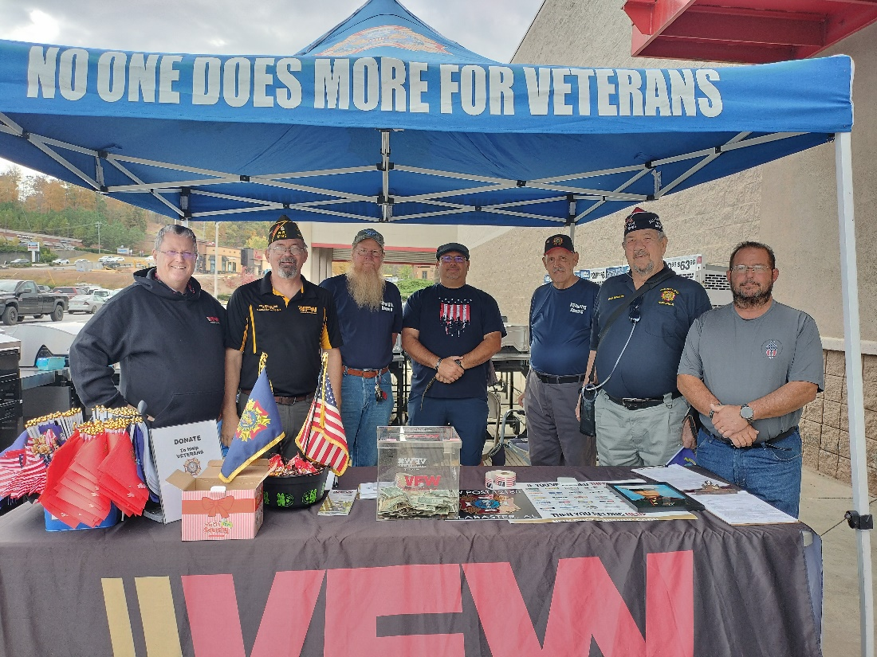
Membership Drives Personnel Contact (Preferred Method)
Membership Recruiting Booth
Meeting
Door-to-door

Slide 3
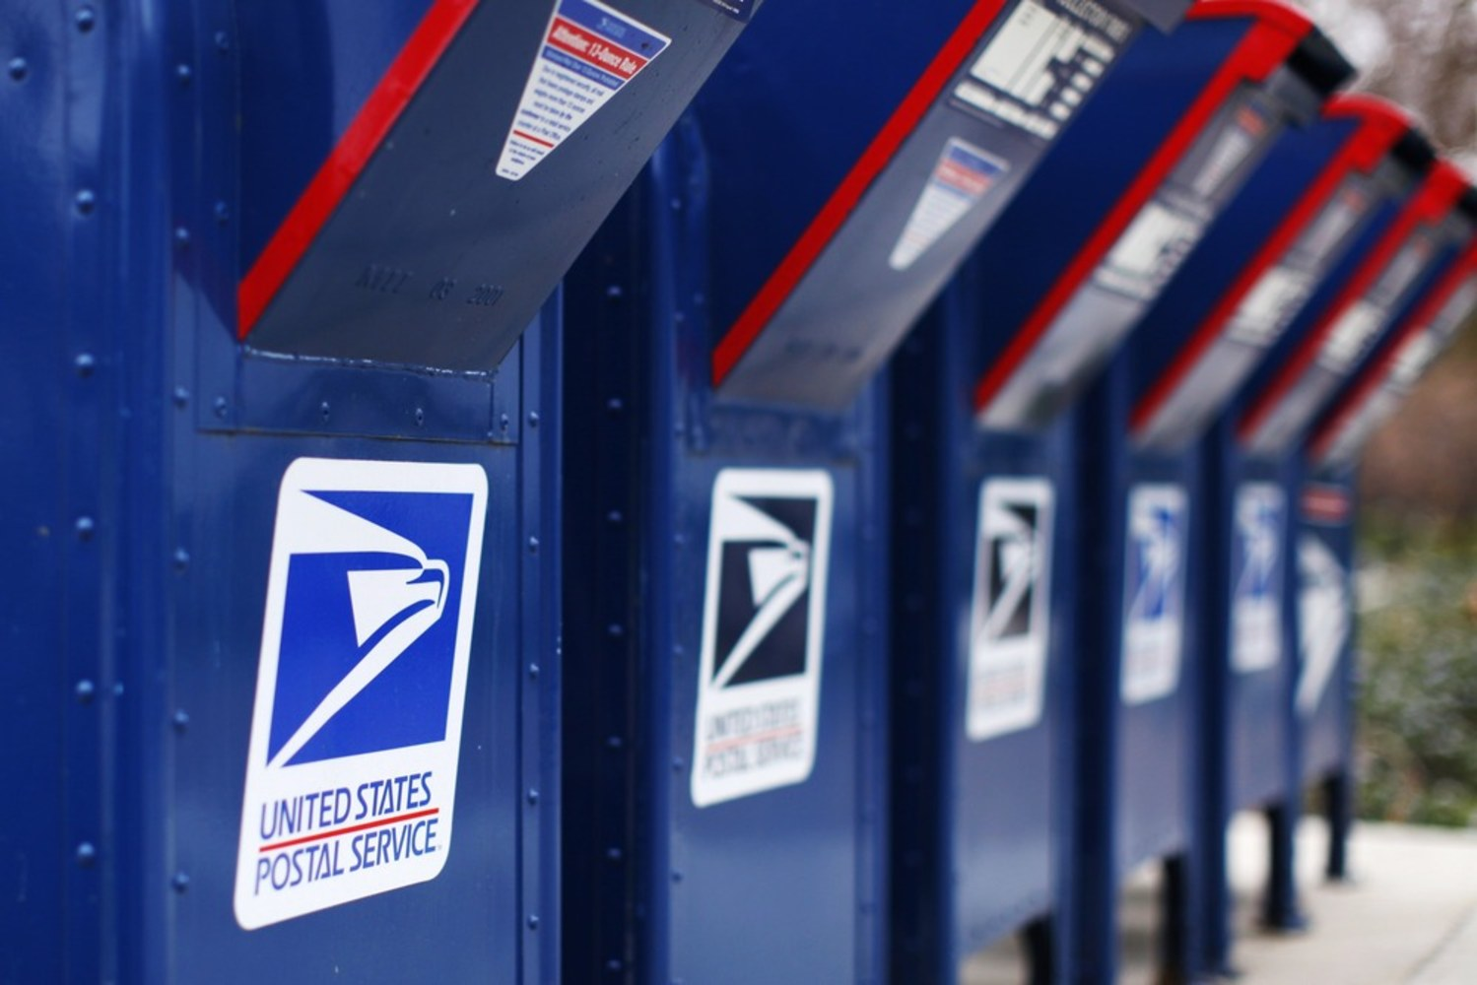
Membership Drives Mail
Expired/relocate list for your zip code
Dues notices
Post Newsletters
Benefits Information

Slide 4
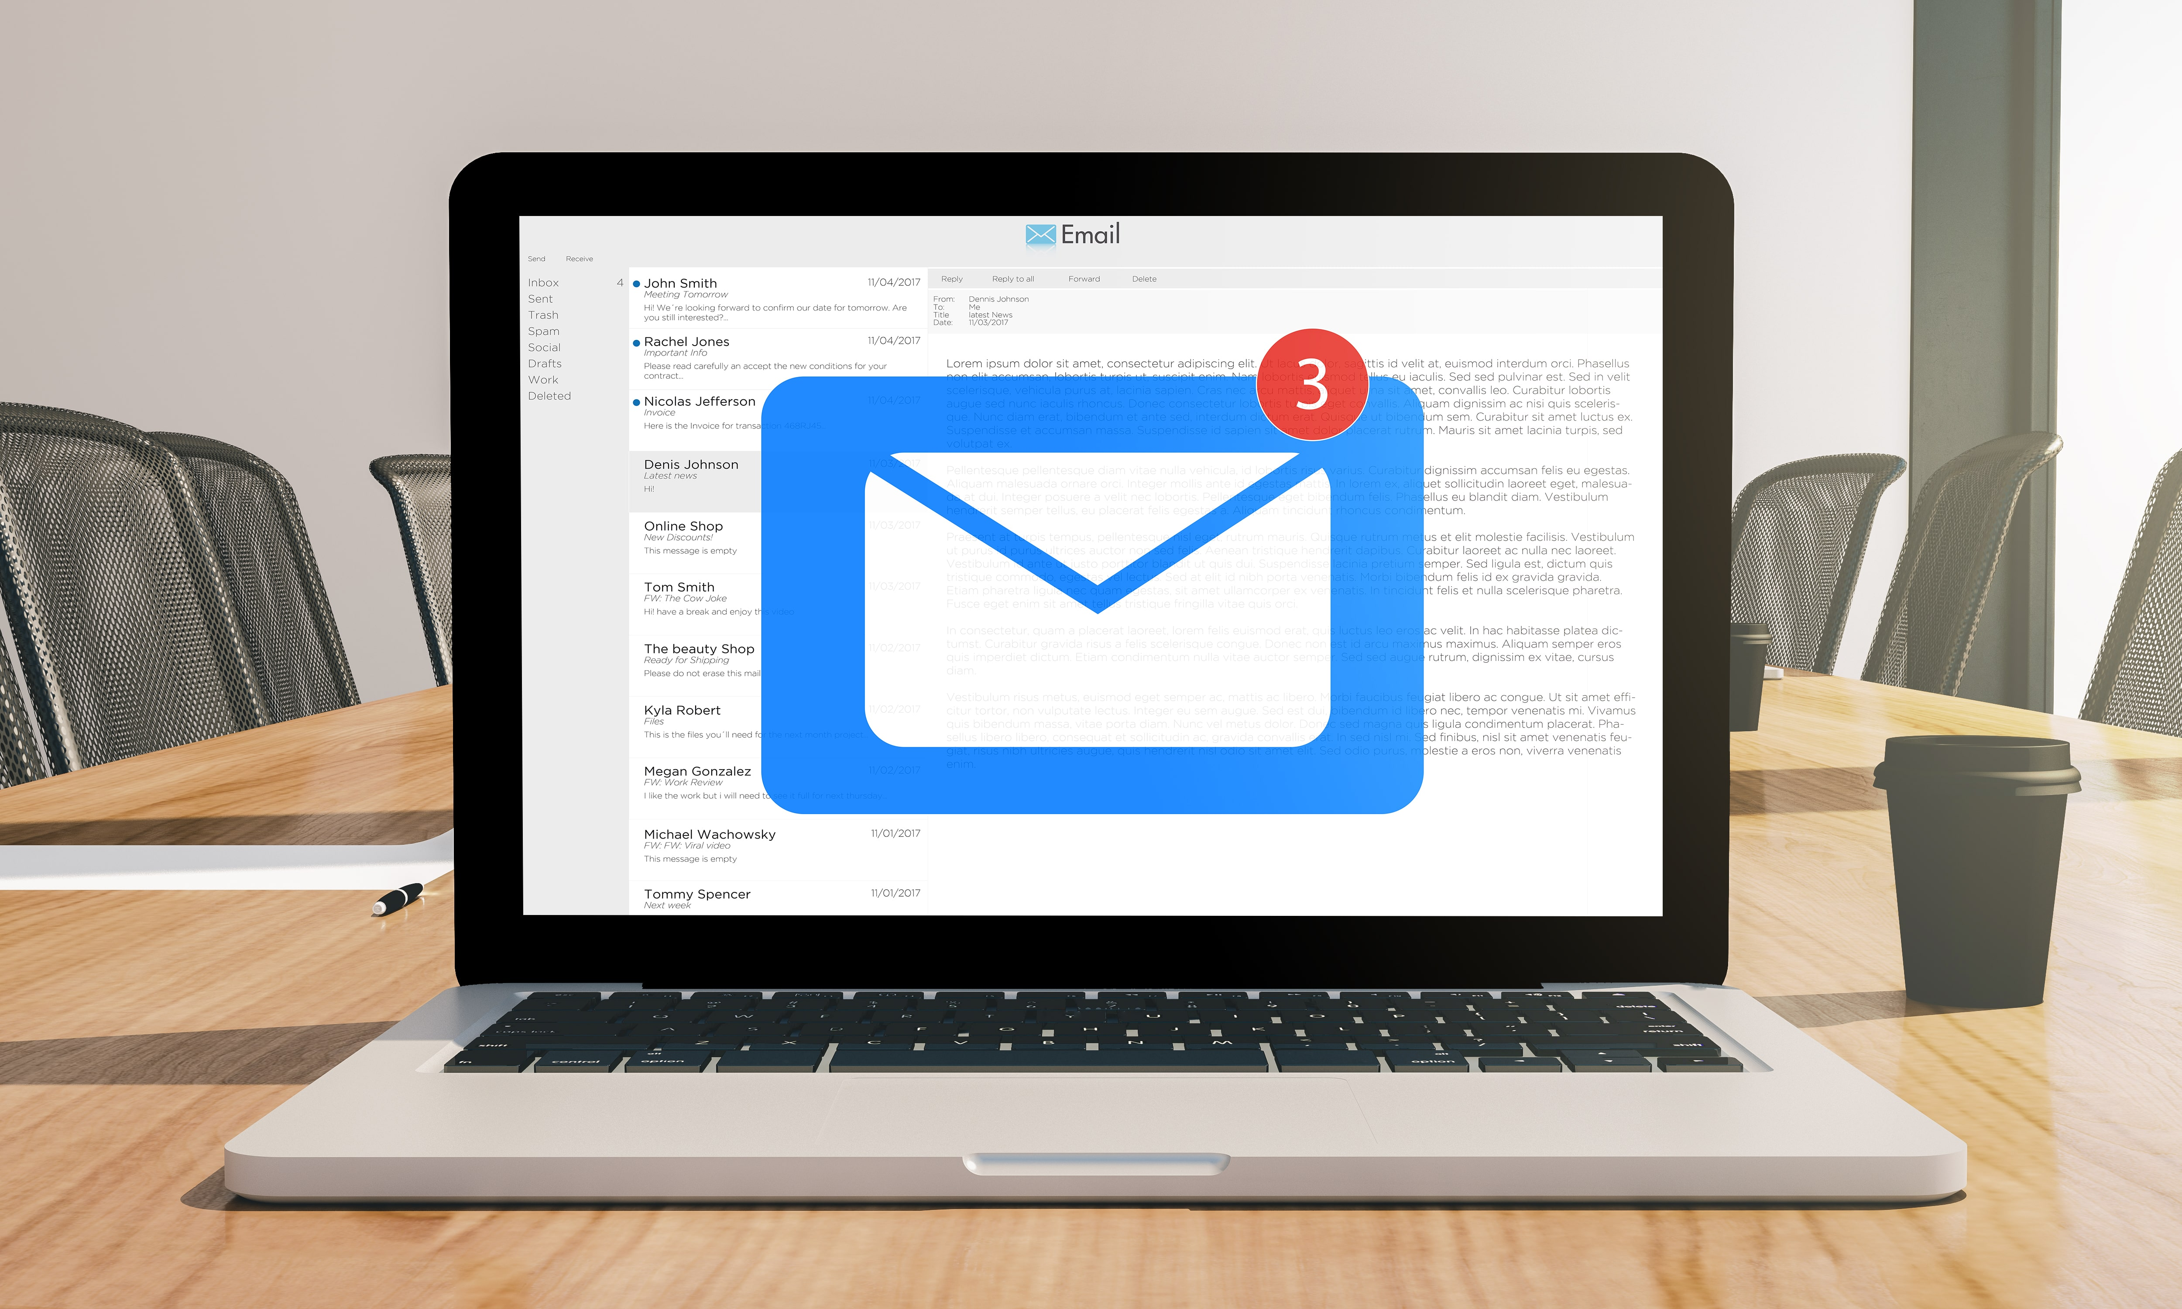
Membership Drives E-Mail / Referrals
This is a great way to stay in touch with your members
Post Members
Family & Friends

Slide 5
Membership Drives Telephone
Fastest way to contact large numbers of members and follow-up on prospect leads generated at other events

Slide 6
Is My Post Dying?
Posts with zero new or reinstated members on MEMSTATS
Posts with Officer’s without Electronic Mail or Phone numbers
Posts failing to provide timely reports to District/Department
Posts reaching 100%, but failing to recruit new members (buying 100%?)
Posts with one or more of the above who fail to request assistance
Posts who do not/Will Not Use Relief Fund!!!!!!!

Slide 7
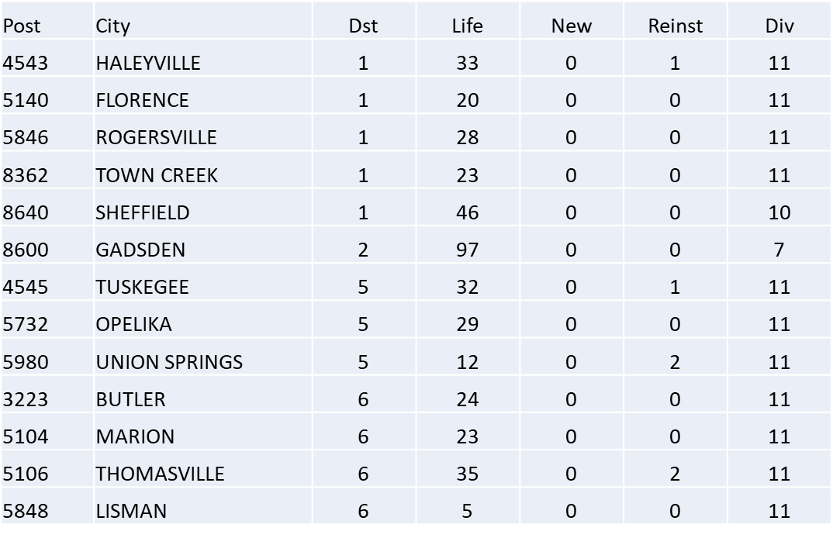
Zero Growth Posts
13 Posts with zero new members on 2022-2023 MEMSTATS

Slide 8
How to Order Brochures
Log into VFW Web site WWW.VFW.ORG
Sign in
Select OMS (Online Membership System)
Select Tools, Products and Merch Tools, Products & Merch
Select Membership Recruiting Brochures Order Form

Slide 9
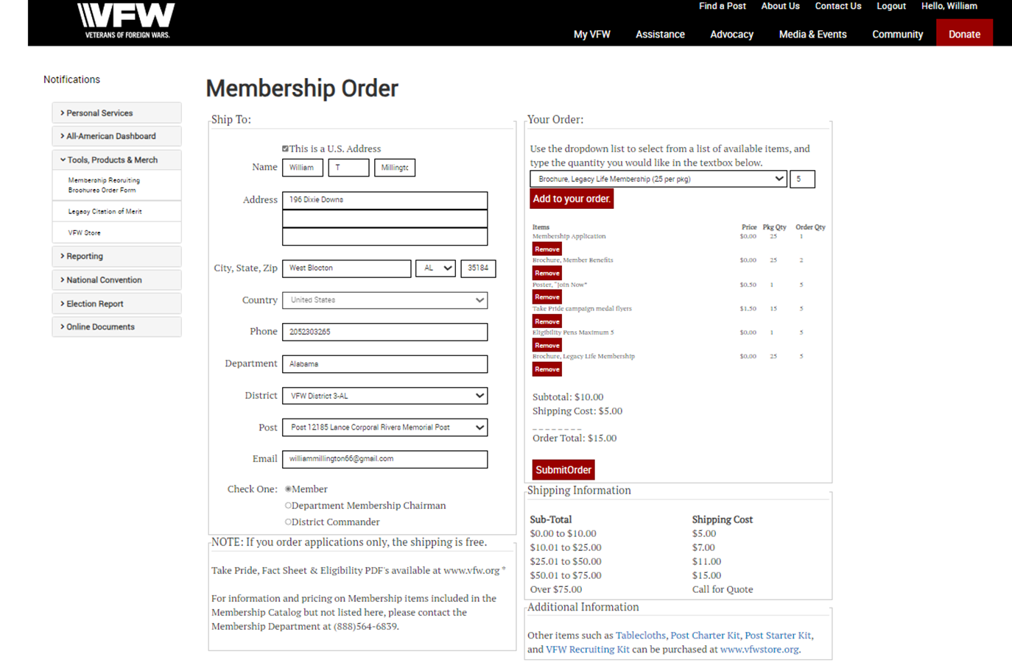
How to Order Brochures

