Slide 1
Membership for Posts

Slide 2
Membership Objectives
• Achieve 102% in Membership
• For everyone to recruit at least one new member and then
mentor that member.
• Increase membership drives and/or events.
• Develop new Posts and/or revitalize existing Posts.
• Increase Life Membership and Legacy Life Membership

Slide 3
Department Recruiting Priorities
• Strength
• Prospects
• Recruitment Meetings
• Recruiter Support
• Recognition
• Media

Slide 4
Department Recruiting Priorities
Quarterly recruiting Events
1st quarter - Post open house/Family day/Christmas Dinner.
2nd quarter – Membership tables at local stores or farmers markets
3rd quarter – Gun show, Home, and Garden shows
4th quarter – Cook-outs and Day of Service.

Slide 5
Membership Retention
Goal 95% Retention Rate
Retention Management
Membership Chairman/Retention Assistant
Sponsorship Program
Awards Program
Auxiliary (Team Work)
Interview

Slide 6
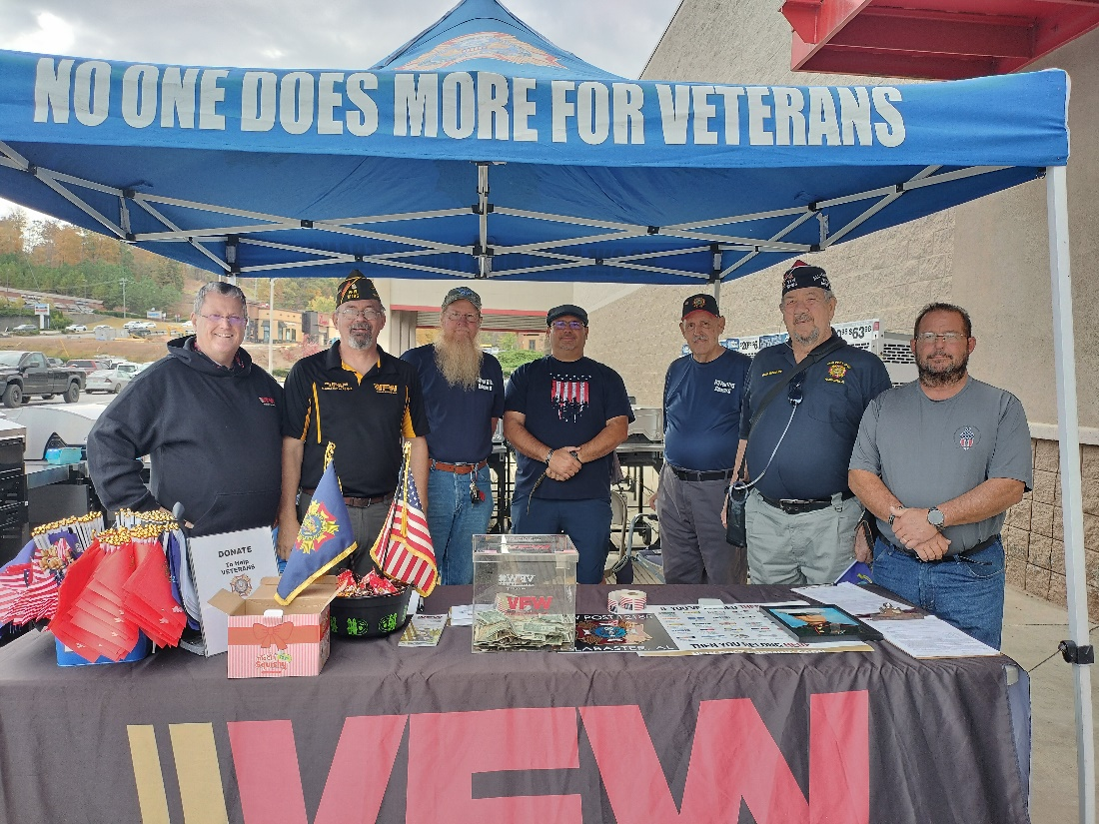
Membership Drives Personnel Contact (Preferred Method)
Membership Recruiting Booth
Meeting
Door-to-door

Slide 7
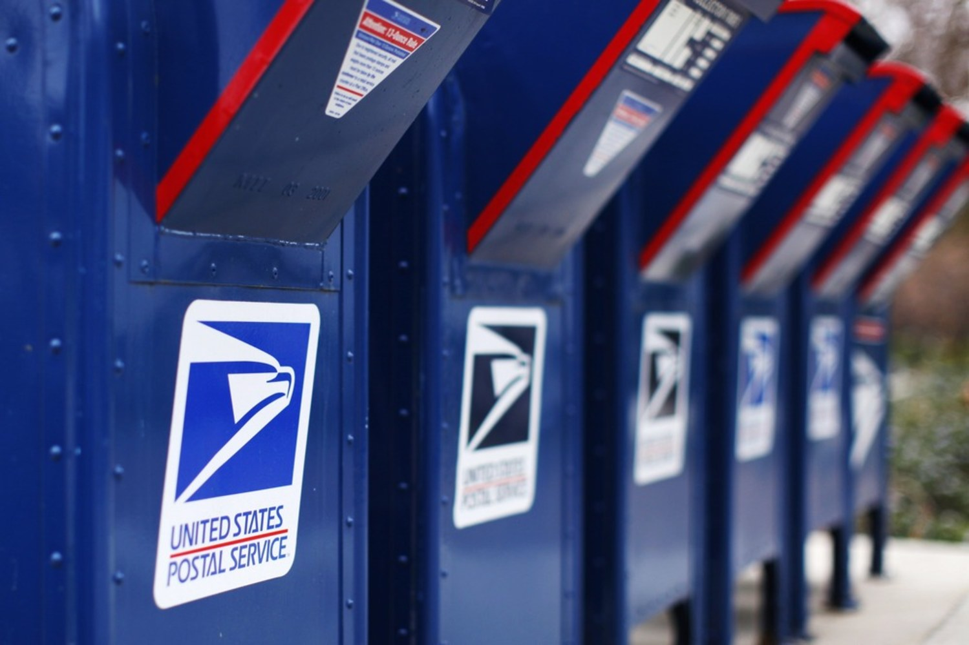
Membership Drives Mail
Expired/relocate list for your zip code
Dues notices
Post Newsletters
Benefits Information

Slide 8
Membership Drives E-Mail / Referrals
This is a great way to stay in touch with your members
Post Members
Family & Friends

Slide 9
Membership Drives Telephone
Fastest way to contact large numbers of members and follow-up on prospect leads generated at other events

Slide 10
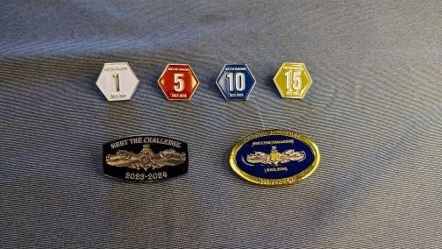
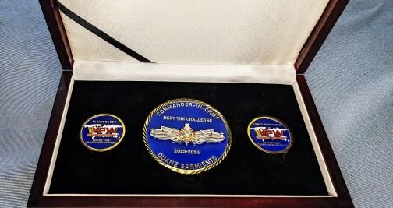
Recruiting Awards
• 1,5, 10, 15 Corresponding numbered member pin
• 25 CIC coin and Citation
• 50 National Aide-De-Camp cap and Citation
• 75 CIC Medallion Set
• 100 Century cap or $50 VFW Store credit & Citation
• 150 CIC Custom Desk Name Plate

Slide 11
Top Department Recruiter
Top Department Recruiter in every Department on July 1, 2024, an Engraved Navy Cutlass
Note: Minimum of 25 new/reinstated members required to win this award.

Slide 12
Are they qualified to join?
• Honorable Discharge
• Campaign Medal
• Pay Stub/Statements ID/HF Pay
• Military orders
• Photographic Proof
• Sworn Statements
If in doubt Call Me !!!!

Slide 13
Are they qualified to join?

Slide 14
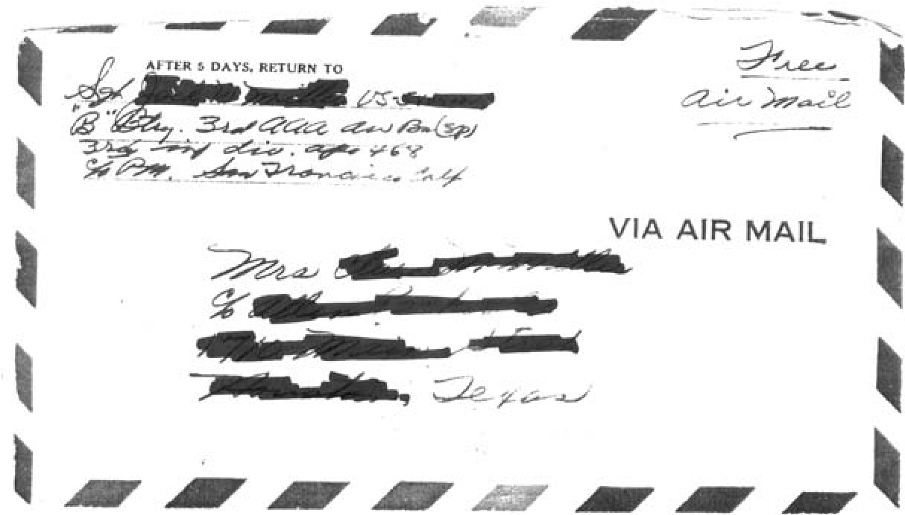
Are they qualified to join?

Slide 15
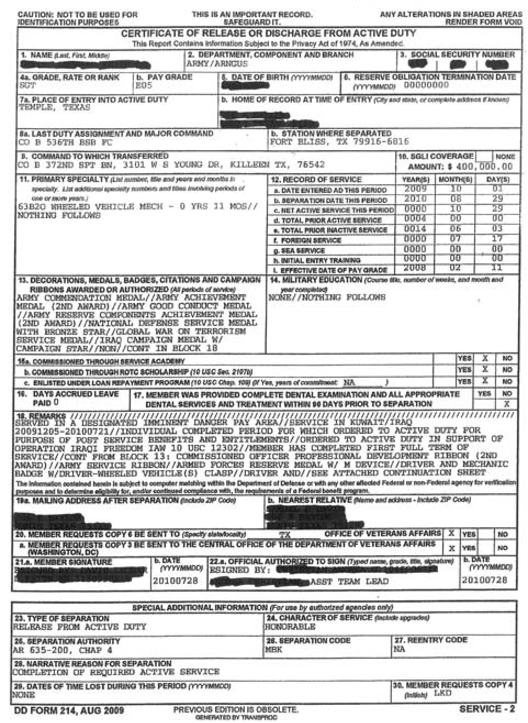
Are they qualified to join?

Slide 16
Is My Post Dying?
Posts with zero new or reinstated members on MEMSTATS
Posts with Officer’s without Electronic Mail or Phone numbers
Posts failing to provide timely reports to District/Department
Posts reaching 100%, but failing to recruit new members (buying 100%?)
Posts with one or more of the above who fail to request assistance
Posts who do not/Will Not Use Relief Fund!!!!!!!

Slide 17
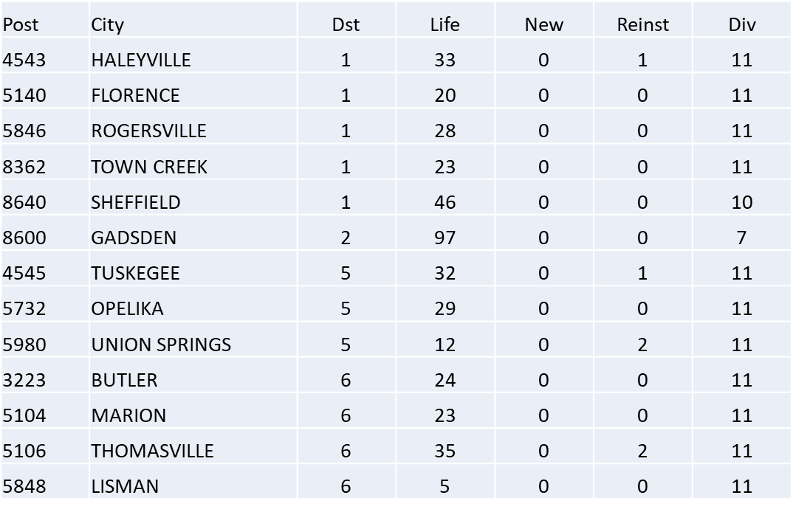
Zero Growth Posts
13 Posts with zero new members on 2022-2023 MEMSTATS

Slide 18
How to Order Brochures
Log into VFW Web site WWW.VFW.ORG
Sign in
Select OMS (Online Membership System)
Select Tools, Products and Merch Tools, Products & Merch
Select Membership Recruiting Brochures Order Form

Slide 19
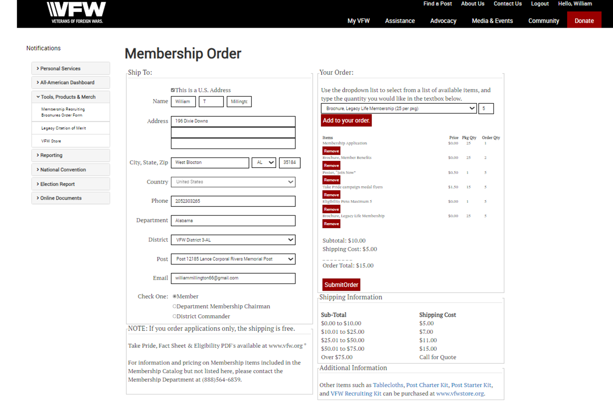
How to Order Brochures

