Slide 1
Social Media, Public Relations
& Website

Slide 2
Social Media

Slide 3
Understanding Your Audience
Who is your audience?​
What do you want to tell them?​
Where is your audience?
​
Are you where you need to be?
​
One size does not fit all.

Slide 4
Understanding Your Audience (cont.)
Internal​
Private Facebook groups​
External​
Veterans​
Potential members​
General Public

Slide 5
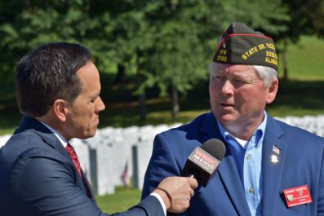
What Should You Post?
Post about what you DO​
Show us – use photos​
Post regularly – at least once a day​
Your page is the public face of your post​
Community engagement begins and ends with social media

Slide 6
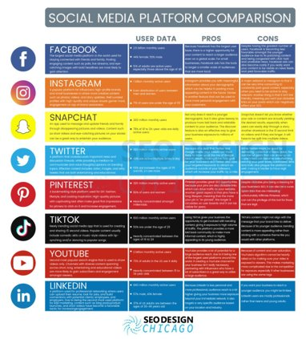
Comparing Platforms

Slide 7
Do I have To?
… only if you want these!

